Slide 1
Computer Architecture Fall 2024 Lecture 02: Performance &RISC-V ISA
Jie Zhang
jiez@pku.edu.cn
[Adapted from Computer Organization and Design, P&H, UCB; Computer Architecture, Guangyu Sun, PKU; Computer Architecture, Myoungsoo Jung, KAIST]

Slide 2
Performance

Slide 3
Performance Metrics
Purchasing perspective
given a collection of machines, which has the
best performance ?
least cost ?
best cost/performance?
Design perspective
faced with design options, which has the
best performance improvement ?
least cost ?
best cost/performance?
Both require
basis for comparison
metric for evaluation
Our goal is to understand what factors in the architecture contribute to overall system performance and the relative importance (and cost) of these factors

Slide 4

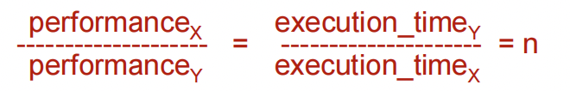
Defining (Speed) Performance
Normally interested in reducing
Response time (aka execution time) – the time between the start and the completion of a task
Important to individual users
Thus, to maximize performance, need to minimize execution time
If X is n times faster than Y, then
Throughput – the total amount of work done in a given time
Important to data center managers
Decreasing response time almost always improves throughput

Slide 5
Machine Clock Rate
Clock rate (MHz, GHz) is inverse of clock cycle time (clock period)
CC = 1 / CR
one clock period
10 nsec clock cycle => 100 MHz clock rate
5 nsec clock cycle => 200 MHz clock rate
2 nsec clock cycle => 500 MHz clock rate
1 nsec clock cycle => 1 GHz clock rate
500 psec clock cycle => 2 GHz clock rate
250 psec clock cycle => 4 GHz clock rate
200 psec clock cycle => 5 GHz clock rate

Slide 6
Performance
Two common measures
Latency (how long to do X)
Also called response time and execution time
Throughput (how often can it do X)
Example of car assembly line
Takes 6 hours to make a car (latency is 6 hours per car)
A car leaves every 5 minutes (throughput is 12 cars per hour)
Overlap results in Throughput > 1/Latency

Slide 7

Clock Cycles per Instruction
Not all instructions take the same amount of time to execute
One way to think about execution time is that it equals the number of instructions executed multiplied by the average time per instruction
Clock cycles per instruction (CPI) – the average number of clock cycles each instruction takes to execute
A way to compare two different implementations of the same ISA
 | CPI for this instruction class
 | A | B | C
CPI | 1 | 2 | 3

Slide 8
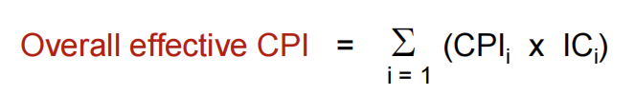
Effective CPI
Computing the overall effective CPI is done by looking at the different types instructions and their individual cycle counts and averaging
Where ICi is the count (percentage) of the number of instructions of class i executed
CPIi is the (average) number of clock cycles per instruction for that instruction class
n is the number of instruction classes
The overall effective CPI varies by instruction mix – a measure of the dynamic frequency of instructions across one or many programs

Slide 9


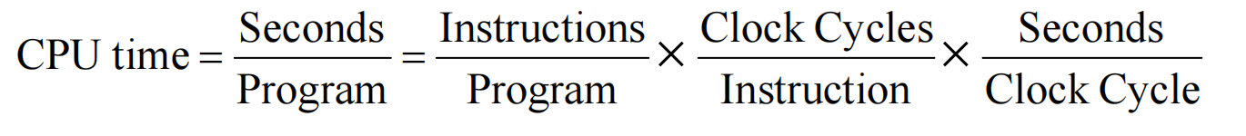



CPU Performance Equation (1)
CPU time = CPU Clock Cycles Clock cycle time
CPU time = Instruction Count Cycles Per Instruction Clock cycle time
ISA, Compiler Technology
Organization, ISA
Hardware Technology, Organization
A.K.A. The “iron law” of performance
Notes:
We cannot simply optimize one factor because all factors are correlated.

Slide 10
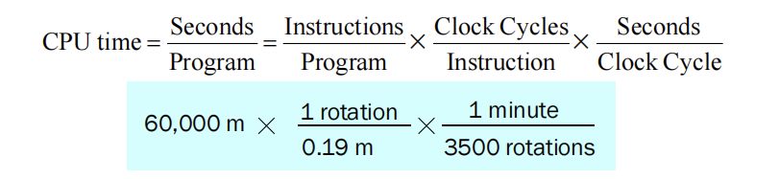
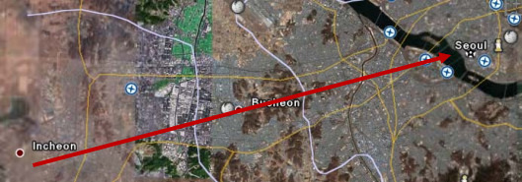
Car Analogy
Drive from SIT to Sinchon
“Clock Speed” = 3500 RPM
“CPI” = 5250 rotations/km or 0.19 m/rot
“Insts” = 60km
= 90 minutes

Slide 11
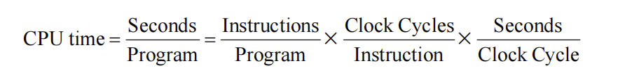
CPU Version
Program takes 33 billion instructions to run
CPU processes instructions at 2 cycles per inst
Clock speed of 3GHz
Sometimes clock cycle time given
instead (ex. cycle = 333 ps)
IPC sometimes used instead of CPI
=22 seconds

Slide 12
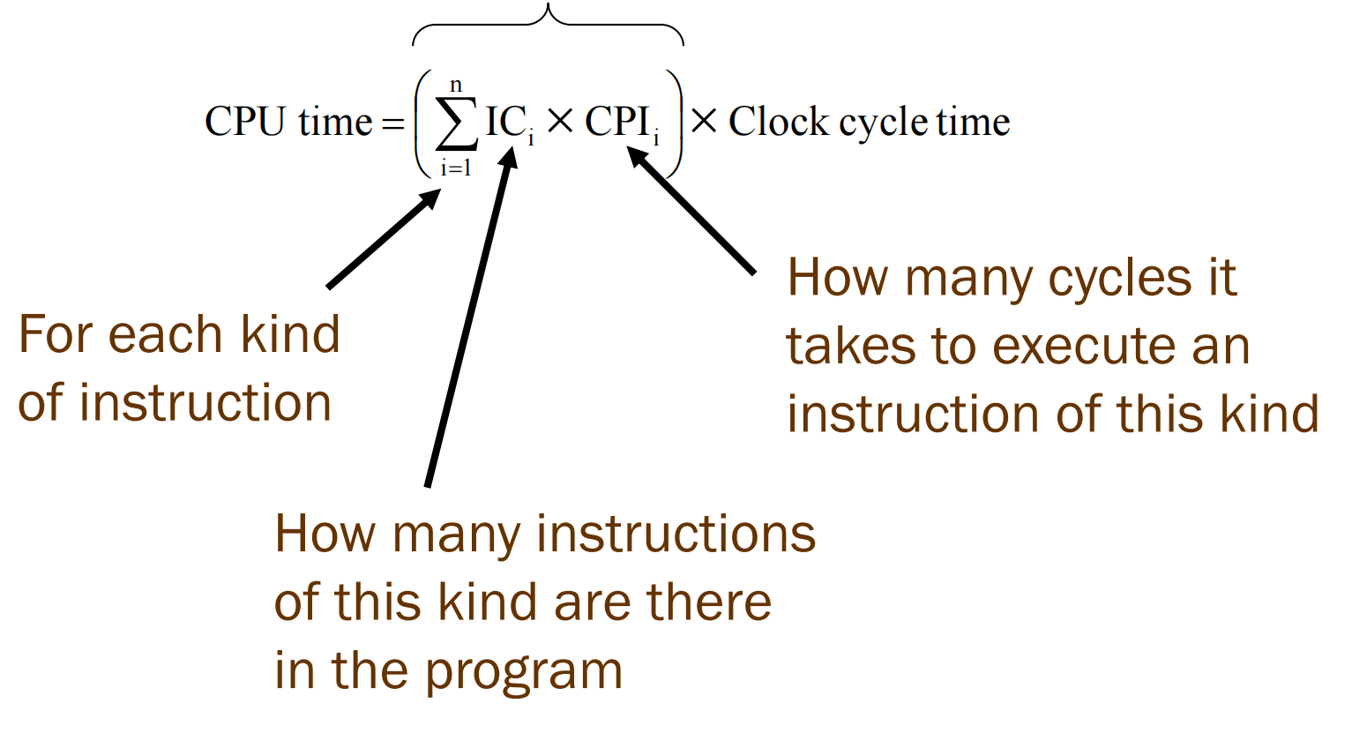
CPU Performance Equation (2)
CPU time = CPU Clock Cycles Clock cycle time
X

Slide 13
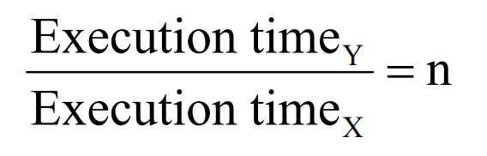
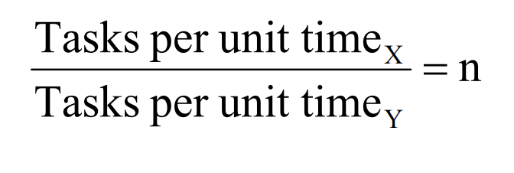
Comparing Performance
“X is n times faster than Y”
“Throughput of X is n times that of Y”

Slide 14
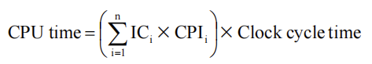
A Simple Example
Op | Freq | CPI_{i} | Freq x CPIi
ALU | 50% | 1
Load | 20% | 5
Store | 10% | 3
Branch | 20% | 2
 |  |  | ∑ =
.5
1.0 .3 .4 2.2
.5
.4 .3 .4 1.6
.5
1.0 .3 .2 2.0
.25
1.0 .3 .4 1.95
How much faster would the machine be if a better data cache reduced the average load time to 2 cycles?
CPU time new = 1.6 x IC x CC so 2.2/1.6 means 37.5% faster
How does this compare with using branch prediction to shave a cycle off the branch time?
CPU time new = 2.0 x IC x CC so 2.2/2.0 means 10% faster
What if two ALU instructions could be executed at once?
CPU time new = 1.95 x IC x CC so 2.2/1.95 means 12.8% faster

Slide 15
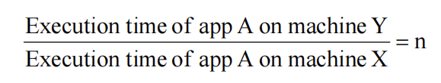


If Only it Were That Simple
“X is n times faster than Y on A”
But what about different applications (or even parts of the same application)
X is 10 times faster than Y on A, and 1.5 times on B, but Y is 2 times faster than X on C, and 3 times on D, and…
Which would you buy?
So does X have better
Performance than Y?

Slide 16
Summarizing Performance
Arithmetic mean
Average execution time
Gives more weight to longer-running programs
Weighted arithmetic mean
More important programs can be emphasized
But what do we use as weights?
Different weight will make different machines look better

Slide 17
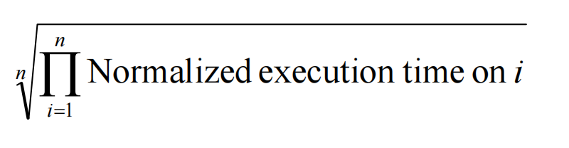
Normalizing & the Geometric Mean
Speedup of arithmetic means != arithmetic mean of speedups
Use geometric mean:
Neat property of the geometric mean: Consistent whatever the reference machine
Do not use the arithmetic mean for normalized execution times

Slide 18
CPI/IPC
Often when making comparisons in comp-arch studies
Program (or set of) is the same for two CPUs
The clock speed is the same for two CPUs
So we can just directly compare CPI’s and often we use IPC’s

Slide 19

Average CPI vs. “Average” IPC
^{CPI}1 ⁺ ^{CPI}2 ⁺ ... ⁺ ^{CPI}N Average CPI =
N
^{IPC}1 ⁺ ^{IPC}2 ⁺ ... ⁺ ^{IPC}N Average IPC =
N
Not Equal 1/CPI!!!
Must use Harmonic Mean to remain ≈ to runtime

Slide 20
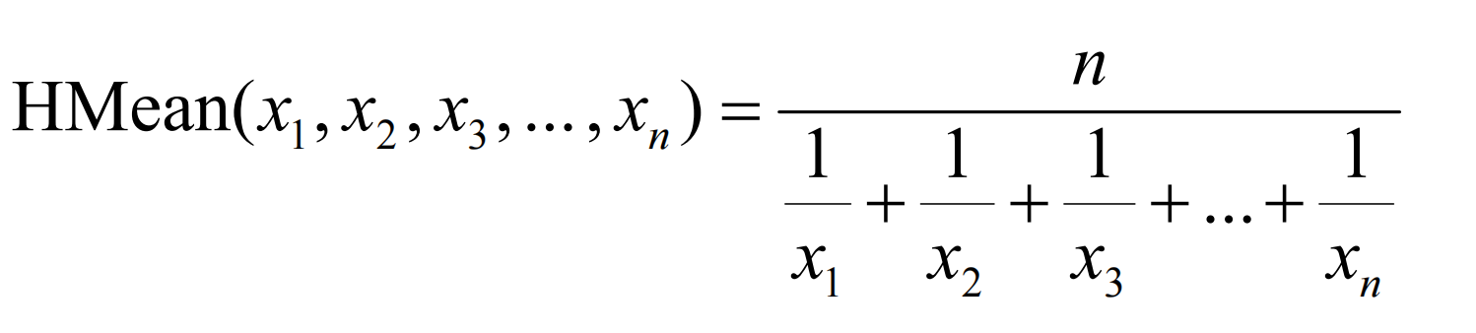
Harmonic Mean
What in the world is this?
– Average of inverse relationships

Slide 21
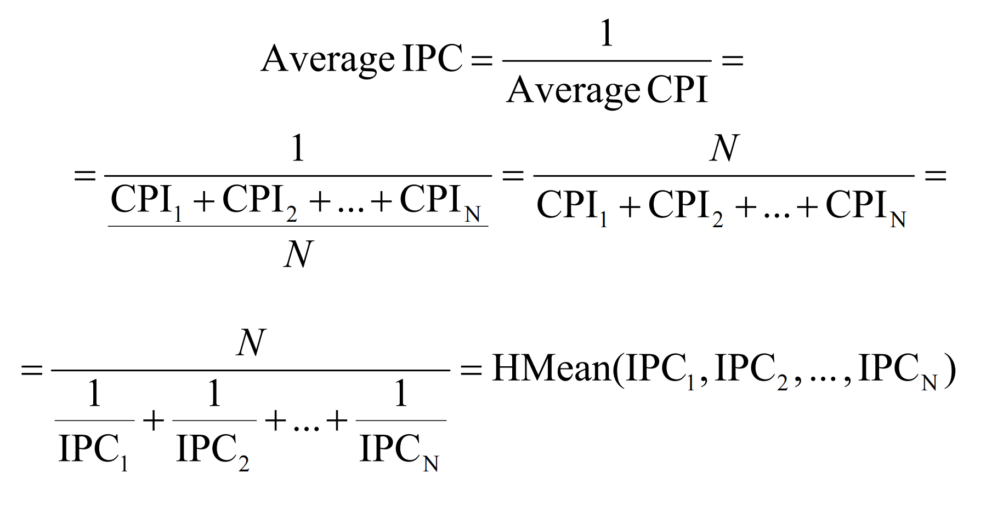
A.M.(CPI) vs. H.M.(IPC)

Slide 22
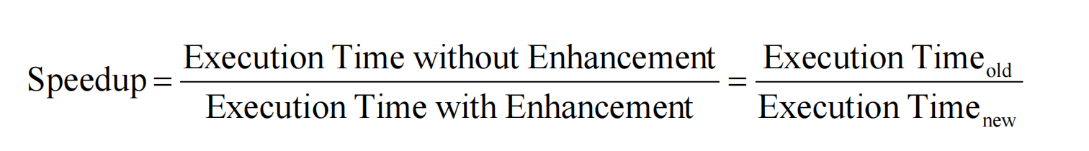
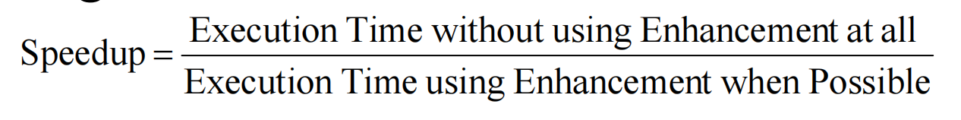
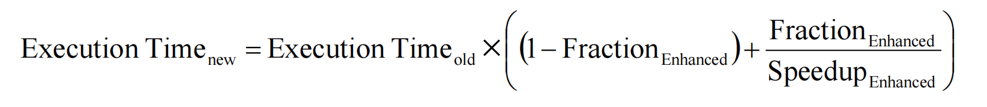
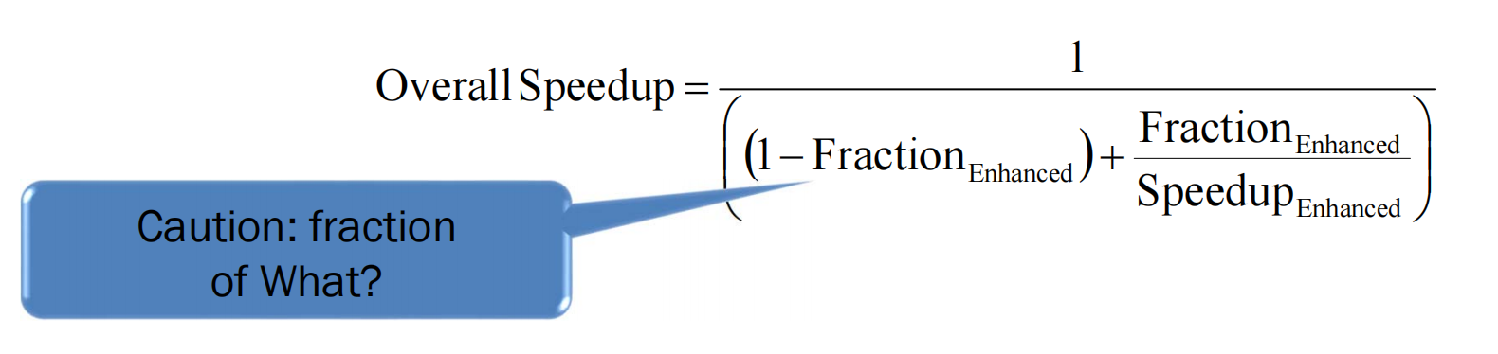
Amdahl’s Law (1)
What if enhancement does not enhance everything?

Slide 23
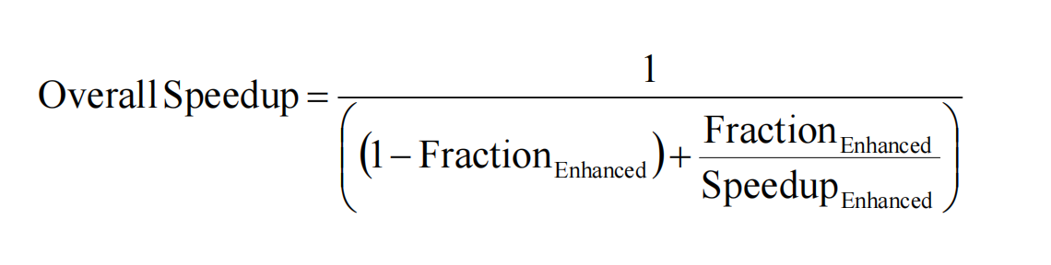
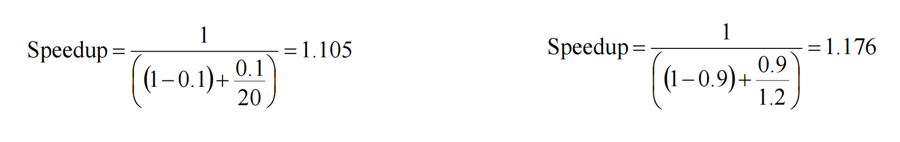
Amdahl’s Law (2)
Make the Common Case Fast
Important: Principle of locality
Approx. 90% of the time spent in 10% of the code

Slide 24
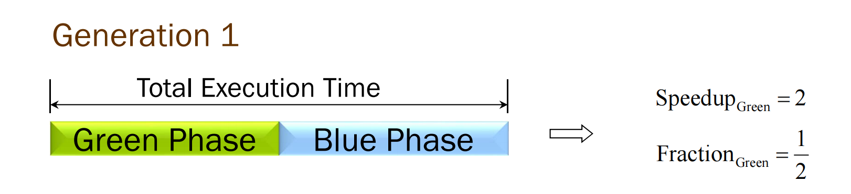
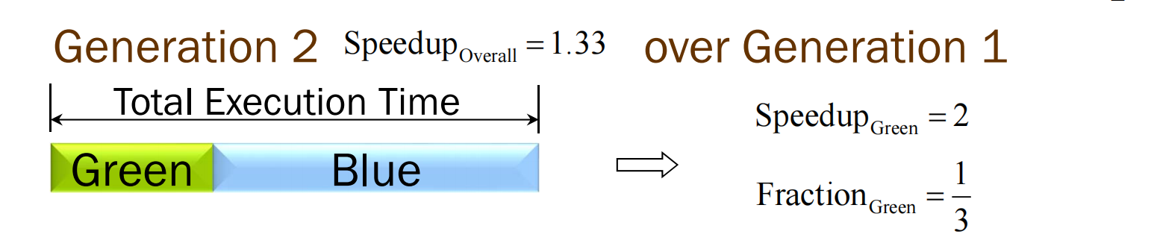
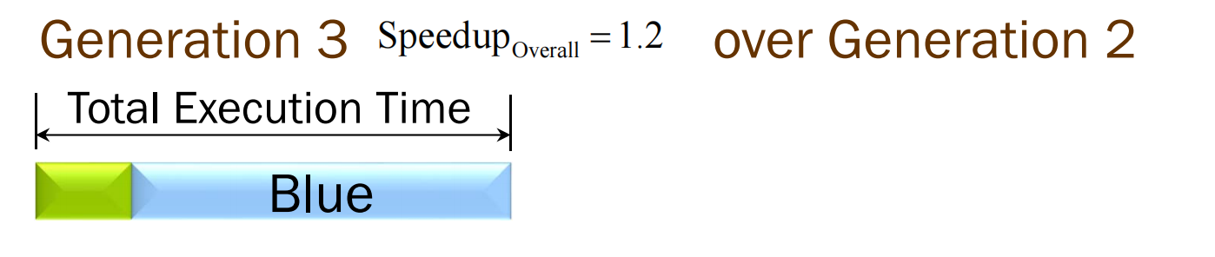
Amdahl’s Law (3)
Diminishing Returns

Slide 25
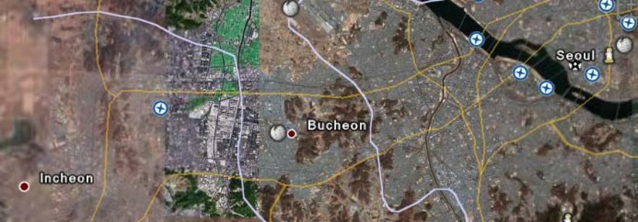

Yet Another Car Analogy
Driving from SIT to Sinchon Campus
you’ve got a “Turbo” for your car, but can only use on the highway
Highway to city border (50 km)
avg. speed of 100 km/h MPH
avg. speed of 200 km/h with Turbo
City border → Sinchon Campus (10 km)
stuck in bad rush hour traffic
• avg. speed of 5 km/h
Turbo gives 100% speedup across 83% of the distance …
… but only results in a 10% reduction on total trip time (which is a 11.1% speedup)

Slide 26
Now Consider Price‐ Performance
Without Turbo
Car costs $8,000 to manufacture
Selling price is $12,000 → $4K profit per car
If we sell 10,000 cars, that’s $40M in profit
With Turbo
Car costs extra $3,000
Selling price is $16,000 → $5K profit per car
But only a few gear heads buy the car:
• We only sell 400 cars and make $2M in profit

Slide 27
CPU Design is Similar
What does it cost me to add some performance enhancement?
How much effective performance do I get out of it?
100% speedup for small fraction of time wasn’t a big win for the car example
How much more do I have to charge for it?
Extra development, testing, marketing costs
How much more can I charge for it?
Does the market even care?
How does the price change affect volume?

Slide 28
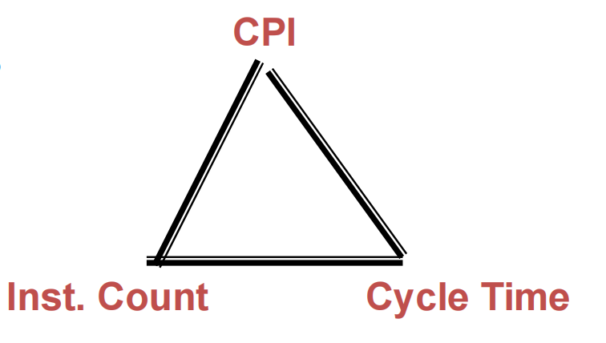
Summary: Evaluating ISAs
Design‐time metrics:
Can it be implemented, in how long, at what cost?
Can it be programmed? Ease of compilation?
Static Metrics:
How many bytes does the program occupy in memory?
Dynamic Metrics:
How many instructions are executed? How many bytes does the processor fetch to execute the program?
How many clocks are required per instruction?
How "lean" a clock is practical?
Best Metric: Time to execute the program!
depends on the instructions set, the processor organization, and compilation techniques.

Slide 29
RISC-V ISA

Slide 30
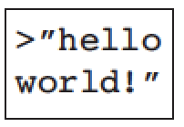


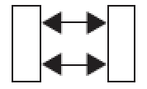
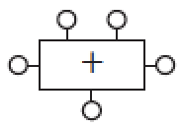

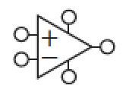


Abstraction Hierarchy
Application Software
Operating System (threads, files, exceptions)
Computer Architecture (instruction set)
Micro-Architecture (execution pipeline)
Logic (adders, multipliers, FSMs)
Digital Circuits (gates)
Analog Circuits (amplifiers)
Process and Devices (MOSFET transistors)
Physics (electrons, holes, tunneling, band gap)
Source: Alex Bronstein

Slide 31
Instruction Set Architecture (ISA)
Indicating which resources (of processor) are needed
Explain how instructions can be encoded as a bitstream
Levels of Program Code
High Level Language
(C++, Python, Java)
Application
x= a+b;
How to program a machine
→ Processor executes instructions as a stream (in a sequence)
Compiler
OS
Assembly Language
(ARM, MIPS, x86)
add R1, R2, R3
Software
Abstraction layer
Instruction Set Architecture
Hardware
What needs to be built
→ Use a wide spectrum of techniques to make CPU faster
CPU Design
Machine Language
Processor
Memory
I/O system
1001 1110 0110 1010

Slide 32

For a given level of function, however, that system is best in which one can specify things with the most simplicity and straightforwardness. … Simplicity and straightforwardness proceed from conceptual integrity. … Ease of use, then, dictates unity of design, conceptual integrity.
The Mythical Man-Month, Brooks, pg 44
Notes:
To make a user-friendly system, the system must have conceptual integrity, which can only be achieved by separating architecture from implementation

Slide 33
For a given level of function, however, that system is best in which one can specify things with the most simplicity and straightforwardness. … Simplicity and straightforwardness proceed from conceptual integrity. … Ease of use, then, dictates unity of design, conceptual integrity.
The Mythical Man-Month, Brooks, pg 44
Notes:
To make a user-friendly system, the system must have conceptual integrity, which can only be achieved by separating architecture from implementation

Slide 34
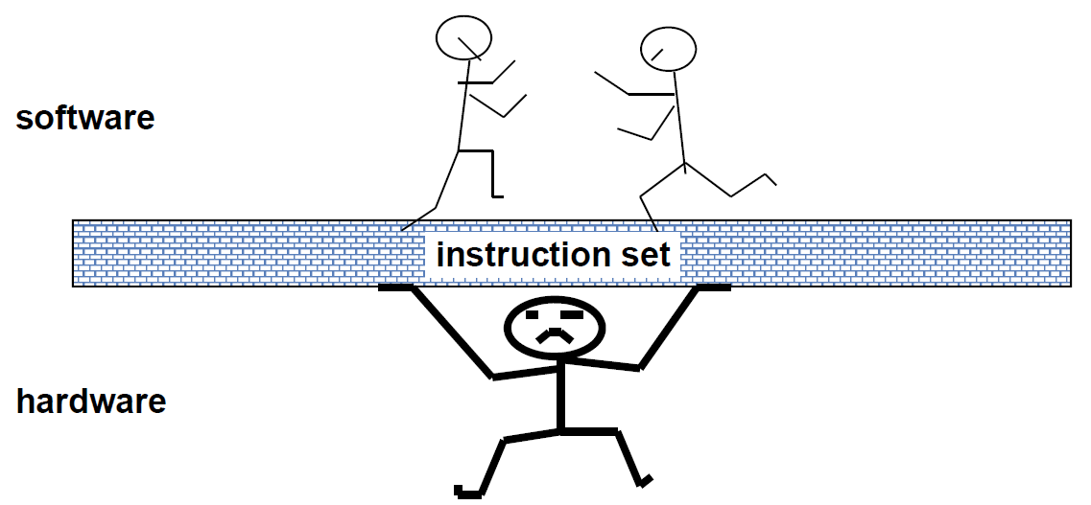
The Instruction Set：a Critical Interface
Properties of a good abstraction:
Lasts through many generations (portability)
Used in many ways (generality)
Provides convenient functionality to higher levels
Permits an efficient implementation at lower levels
Notes:
家里的狗：

Slide 35
Definitions
The words of a computer’s language are called instructions, and its vocabulary is called an instruction set.
The similarity of instruction sets occurs because all computers are constructed from hardware technologies based on similar underlying principles and because there are a few basic operations that all computers must provide.
Computer designers have a common goal: to find a language that makes it easy to build the hardware and the compiler while maximizing performance and minimizing cost and energy.
What is ISA （Instruction Set Architecture）?
Notes:
家里的狗：

Slide 36
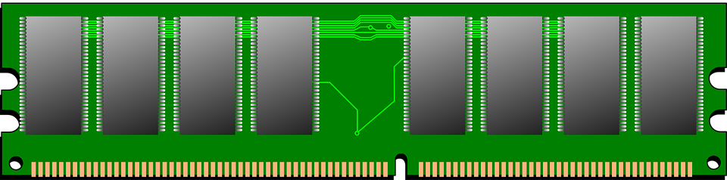
(vonNeumann) Processor Organization
needs to have the
Memory
Datapath
Components – the functional units and storage (e.g., register file) needed to execute instructions
Interconnects - components connected so that the instructions can be accomplished and so that data can be loaded from and stored to Memory
Fetch
(Store)
Bus Interface Unit
Registers
needs to
Control
Bring input instructions from Memory
Issue signals to control the information flow between the Datapath components and to control what operations they perform
Manage instruction sequencing
Control Unit
ALU / FPU
Decode
Execute

Slide 37
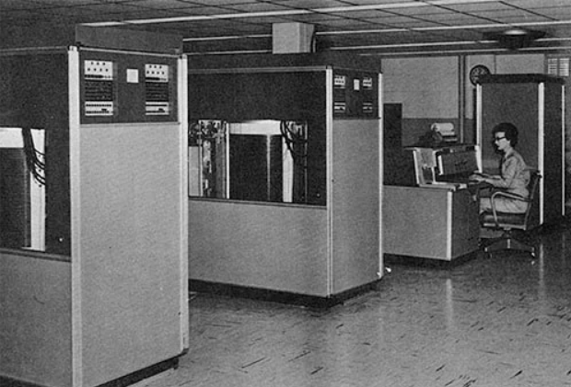
History of ISA designs
Long long ago, resources are limited:
Memory: very expensive and very small capacity
Most programmers work on assembly languages
CISC (Complex Instruction Set Computer)
Dense instruction size (1~15 Bytes)
Programmer friendly
Complexity: almost 1 new instructions per month
Hardware unfriendly: compiler, registers, state machines
e.g., a = a * b
CISC assembly instruction:
MULT 2:3, 5:2
IBM 1st hard disk (5MB in total)

Slide 38
RISC
RISC (Reduced Instruction Set Computer) philosophy
fixed instruction lengths
load-store instruction sets
limited addressing modes
limited operations
e.g., a = a * b
CISC assembly instruction: RISC assembly instruction:
MULT 2:3, 5:2 LOAD A, 2:3
LOAD B, 5:2
PROD A, B
STORE 2:3, A
ARM, RISC-V, MIPS, Sun SPARC, HP PA-RISC, IBM PowerPC, Intel (Compaq) Alpha, …

Slide 39
RISC: Past, Present, and Future
PC Era
Hardware translates x86 instructions into internal RISC instructions
Then use any RISC technique inside MPU
> 350M / year !
x86 ISA eventually dominates servers as well as desktops
PostPC Era: Client/Cloud
IP in SoC vs. MPU
Value die area, energy as much as performance
> 20B total / year in 2017
x86 in PCs peaks in 2011, now decline ~8% / year (2016 < 2007)
x86 servers ⇒ Cloud ~10M servers total* (0.05% of 20B)
99% Processors today are RISC
Source: P&H Turing Award Talk* “A Decade of Mobile Computing”, Vijay Reddi, 7/21/17, Computer Architecture Today

Slide 40

What is RISC-V
• RISC-V (pronounced "risk-five”) is a ISA standard
– An open source implementation of a reduced instruction set computing (RISC) based instruction set architecture (ISA)
– There was RISC-I, II, III, IV before
• Most ISAs: X86, ARM, Power, MIPS, SPARC
– Commercially protected by patents
– Preventing practical efforts to reproduce the computer systems.
• RISC-V is open
– Permitting any person or group to construct compatible computers
– Use associated software
• Originated in 2010 by researchers at UC Berkeley
– Krste Asanović, David Patterson and students
• 2017 version 2 of the userspace ISA is fixed
– User-Level ISA Specification v2.2
– Draft Compressed ISA Specification v1.79
– Draft Privileged ISA Specification v1.10

Slide 41
Goals in Defining RISC-V
• A completely open ISA that is freely available to academia and industry
• An ISA that avoids "over-architecting" for
– a particular microarchitecture style (e.g., microcoded, in-order, decoupled, out-of- order) or
– implementation technology (e.g., full-custom, ASIC, FPGA), but which allows efficient implementation in any of these
• RISC-V ISA includes
– A small base integer ISA, usable by itself as a base for customized accelerators or for educational purposes, and
– Optional standard extensions, to support general-purpose software development
– Optional customer extensions
• Support for the revised 2008 IEEE-754 floating-point standard

Slide 42
RISC-V ISA Principles
• Generally kept very simple and extendable
• Separated into multiple specifications
– User-Level ISA spec (compute instructions)
– Compressed ISA spec (16-bit instructions)
– Privileged ISA spec (supervisor-mode instructions)
– More …
• ISA support is given by RV + word-width + extensions supported
– E.g. RV32I means 32-bit RISC-V with support for the I(nteger) instruction set

Slide 43
User Level ISA
• Defines the normal instructions needed for computation
– A mandatory Base integer ISA
• I: Integer instructions:
– ALU
– Branches/jumps
– Loads/stores
– Standard Extensions
• M: Integer Multiplication and Division
• A: Atomic Instructions
• F: Single-Precision Floating-Point
• D: Double-Precision Floating-Point
• C: Compressed Instructions (16 bit)
• G = IMAFD: Integer base + four standard extensions
– Optional extensions

Slide 44
RISC-V Instruction Set Architecture (ISA)
Registers
Instruction Categories
Arithmetic, Logical, Shift
Data transfer
Un-/Conditional branch
x0 - x31
6 Instruction Formats: all 32 bits wide
PC
31
7 bits
5 bits
5 bits
3 bits
5 bits
7 bits
0
funct7
rs2
rs1
funct3
rd
opcode
R format
immediate
rs1
funct3
rd
opcode
I format
imm[11:5]
rs2
rs1
funct3
imm[4:0]
opcode
S format
imm[12,10:5]
rs2
rs1
funct3
imm[4:1,11]
opcode
SB format
immediate[31:12]
rd
opcode
U format
immediate[20,10:1,11,19:12]
rd
opcode
UJ format

Slide 45
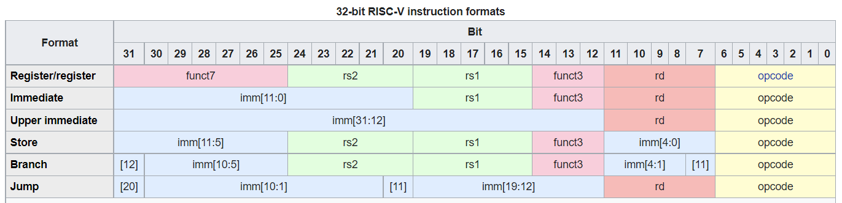
Question review
“Wired” orders of immediate
Sign bit
imm[10:5]
imm[19:12]
imm[4:1]
https://five-embeddev.com/riscv-isa-manual/latest/a.html#

Slide 46
Issues to be Explored
Instruction Types
R, I, S, SB, U and UJ
How to identify/encode these instructions?
How to process data?
Data types supported
Where to store data?
Addressing methods

Slide 47
RISC-V Arithmetic Instructions
RISC-V assembly language arithmetic statement
add x5, x6, x7
sub x5, x6, x7
1
Each arithmetic instruction performs ______ operation
Each arithmetic instruction fits in 32 bits and specifies exactly ____ operands
3
destination source1 op source2
Operand order is fixed (destination first)
Those operands are all contained in the ___________ (x5,x6,x7)
Register File

Slide 48
Aside: RISC-V Register Convention
Name | Register Number | Usage
x0 | 0 | the constant value 0
x1 (ra) | 1 | return address (link register)
x2 (sp) | 2 | stack pointer
x3 (gp) | 3 | global pointer
x4 (tp) | 4 | thread pointer
x5 - x7 | 5-7 | temporaries
x8 - x9 | 8-9 | frame pointer/saved
x10 - x17 | 10-17 | arguments/results
x18 - x27 | 18-27 | saved
X28 - x31 | 28-31 | temporaries

Slide 49
RISC-V Register File
Register File
Holds thirty-two 64-bit registers
How many read ports ?
How many write ports?
64 bits
2
src1 addr
src1 data
1
src2 addr
32
locations
des addr
Registers are
Faster than other memory levels
But register files with more locations are slower (e.g., a 64-word file could be as much as 50% slower than a 32-word file)
Read/write port increase impacts speed quadratically
Easier for a compiler to use
e.g., (A*B) – (C*D) – (E*F) can do multiplies in any order vs. stack
Can hold variables so that
code density improves (since register are named with fewer bits than a memory location)
write data
src2 data
write control

Slide 50
Machine Language - Add Instruction
Instructions, like registers and words of data, are 32 bits long
Arithmetic Instruction Format (R format):
add x5, x6, x7
funct7 rs2 rs1 funct3 rd opcode
7
5
5
3
5
7
opcode 7-bits opcode that specifies the operation
rs1 5-bits register file address of the first source operand
rs2 5-bits register file address of the second source operand
rd 5-bits register file address of the result’s destination
funct3 3-bits function code augmenting the opcode
funct7 7-bits function code augmenting the opcode

Slide 51
RISC-V Memory Access Instructions
RISC-V has two basic data transfer instructions for accessing memory
ld x5, 24(x6) #load doubleword from memory
sd x5, 24(x6) #store doubleword to memory
The data is loaded into (ld) or stored from (sd) a register in the register file – a ___ bit address
The memory address – a ____bit address – is formed by adding the contents of the base address register to the offset value
A 12-bit field meaning access is limited to memory locations within a region of ±2⁸ or 256 doublewords (±2¹¹ or 2048 bytes) of the address in the base register
Note that the offset can be positive or negative
5
64

Slide 52
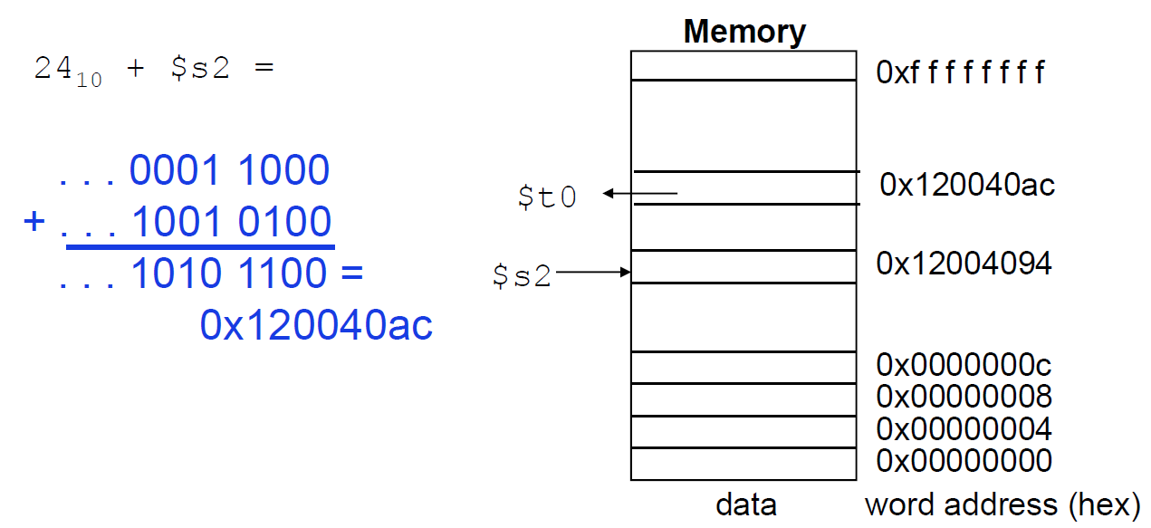
Machine Language - Load & Store Instruction
Load Instruction Format (I format):
ld x5, 24 ( x6)
immediate
rs1
funct3
rd
opcode
I format
x6
x5
x6
Omit the MSB 32-bit addresses

Slide 53
Machine Language - Load & Store Instruction
Load Instruction Format (I format):
ld x5, 24 ( x6)
immediate
rs1
funct3
rd
opcode
I format
Store Instruction Format (S format):
sd x5, 24 ( x6)
imm[11:5]
rs2
rs1
funct3
imm[4:0]
opcode
S format

Slide 54
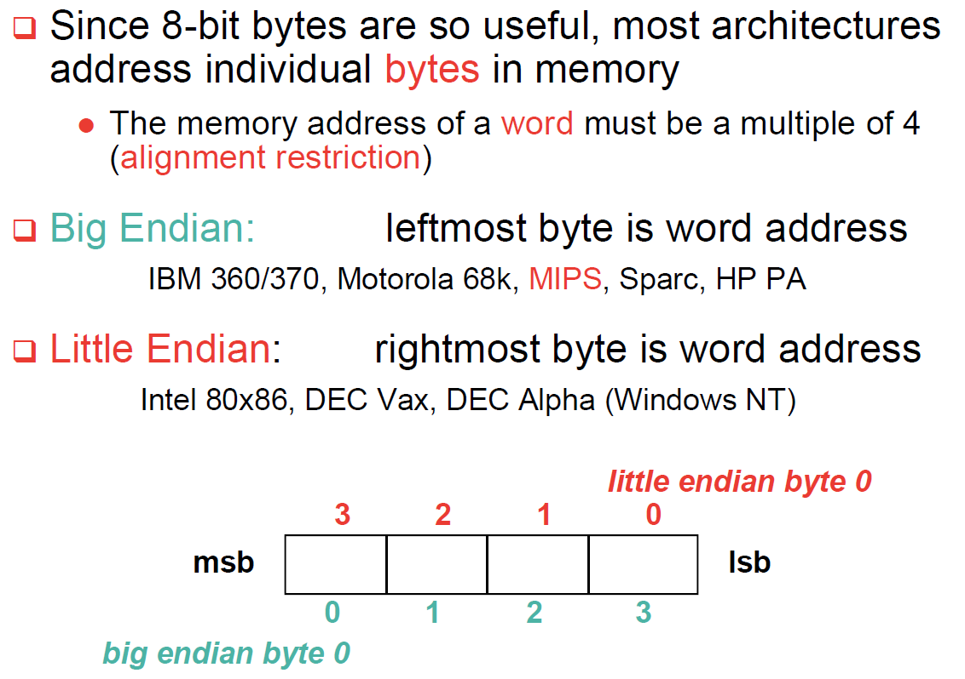
Byte Addresses
, RISC-V

Slide 55
Loading and Storing Bytes
RISC-V provides special instructions to move bytes
lb x5, 40(x6) #load byte from memory
sb x5, 40(x6) #store byte to memory
lb
immediate
rs1
funct3
rd
opcode
What 8 bits get loaded and stored?
load byte places the byte from memory in the least significant 8 bits of the destination register
what happens to the other bits in the register?
store byte takes the byte from the least significant 8 bits of a register and writes it to a byte in memory
what happens to the other bits in the memory word?

Slide 56
Immediate Instructions
Small constants are used often in typical code
Possible approaches?
put “typical constants” in memory and load them
create hard-wired registers (like $zero) for constants like 1
have special instructions that contain constants !
addi sp, sp, 4 #sp = sp + 4
Machine format (I format):
immediate
rs1
funct3
rd
opcode
I format

Slide 57
How About Larger Constants?
We'd also like to be able to load a long constant into a register, for this we have a new "load upper immediate" instruction
lui x5, 34534
lui loads a 20-bit constant into bits 12 through 31 of a register. The most significant 32 bits are filled with copies of bit 31, and the least significant 12 bits are filled with zeros.
immediate[31:12]
rd
opcode
U format

Slide 58
RISC-V Control Flow Instructions
RISC-V conditional branch instructions:
beq rs1, rs2, L1 #go to Ll if rs1==rs2 bne rs1, rs2, L1 #go to Ll if rs1!=rs2
Ex: if (i==j) h = i + j;
bne x22, x23, L1 add x19, x22, x23 L1: ...
Instruction Format (SB format):
imm[12,10:5]
rs2
rs1
funct3
imm[4:1,11]
opcode
How is the branch destination address specified?

Slide 59
Specifying Branch Destinations
Use a register (like in lw and sw) added to the 12-bit offset
which register? Instruction Address Register (____ )
its use is automatically implied by instruction
PC gets updated (PC+4) during the fetch cycle so that it holds the address of the next instruction
limits the branch distance to -2¹⁰ to +2¹⁰-1 words from the (instruction after the) branch instruction, but most branches are local anyway
PC
imm[12,10:5]
rs2
rs1
funct3
imm[4:1,11]
opcode
Add
branch dst
address
PC
1
0
?
Add
4

Slide 60
Instructions for Accessing Procedures
RISC-V procedure call instruction: jal x1, ProcedureAddress #jump and link
Saves PC+4 in register $x1 to have a link to the next instruction for the procedure return
Machine format (UJ format):
Return instruction: jalr x0, 0(x1) #jump and link register
immediate[20,10:1,11,19:12]
rd
opcode
Question: how about unconditional jump/branch?
Answer: jal x0, Label

Slide 61
Unconditional Branch
Use register x0 to help
jal x0, Label #unconditionally branch to Label
A long jump with jalr
lui x5, 32423
jalr x1, 2342(x5)

Slide 62
Instructions for Accessing Procedures
Recall how function works in
the programming language:
Parameters;
Reserve caller’s info；
Global variables；
Name | Register Number | Usage | Preserve on call?
x0 | 0 | the constant value 0 | n.a.
x1 (ra) | 1 | return address (link register) | caller
x2 (sp) | 2 | stack pointer | callee
x3 (gp) | 3 | global pointer | --
x4 (tp) | 4 | thread pointer | --
x5 - x7 | 5-7 | temporaries | caller
x8 - x9 | 8-9 | frame pointer/saved | callee
x10 - x17 | 10-17 | arguments/results | caller
x18 - x27 | 18-27 | saved | callee
X28 - x31 | 28-31 | temporaries | caller

Slide 63
Spilling Registers
What if the callee needs more registers? What if the procedure is recursive?
uses a ______ – a last-in-first-out queue – in memory for passing additional values or saving (recursive) return address(es)
stack
One of the general registers, sp (x2), is used to address the stack (which “grows” from high address to low address)
add data onto the stack – ____
sp = sp – 4
data on stack at new $sp
remove data from the stack – ____
data from stack at $sp sp = sp + 4
high addr
push
top of stack
$sp
pop
low addr

Slide 64
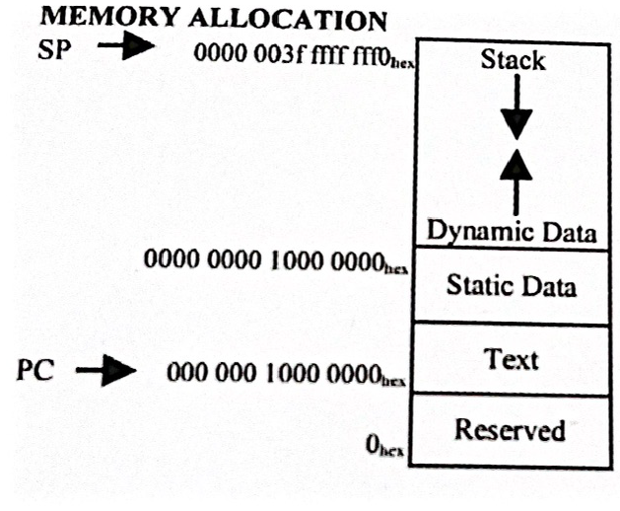
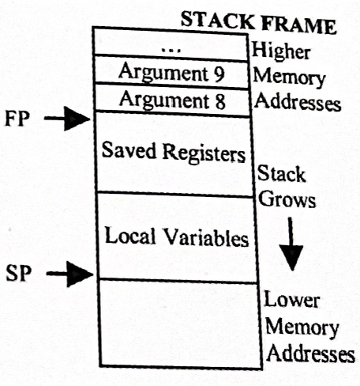
Spilling Registers (cont.)
How does memory allocation look like?
Argument reg.
Return address
Saved reg.

Slide 65
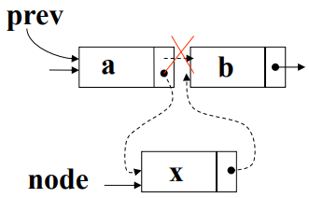
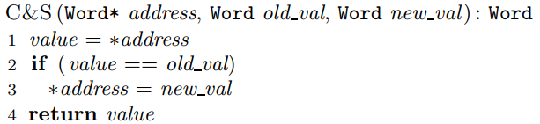
Instructions for Synchronization
Synchronization primitive:
A simple lock: the value 0 is used to indicate that the lock is free and 1 is used to indicate that the lock is unavailable
Hardware: atomic exchange or atomic swap
Recall: C&S primitive in CISC

Slide 66
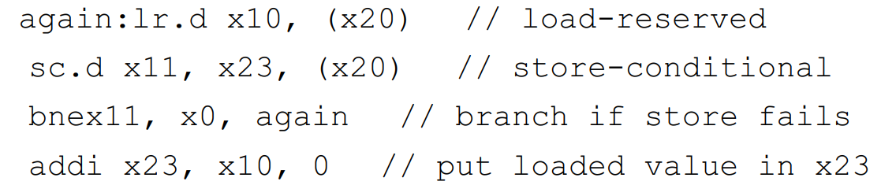
Instructions for Synchronization (cont.)
C&S is a complex instruction, so RISC-V uses two R-type commands to replace it:
lr.d x5, (x6) # x5 = Memory[x6]
sc.d x7, x5, (x6) # Memory[x6] = x5; x7=0/1
lr.d: load-reserved doubleword;
sc.d: store-conditional doubleword;
Function: if the contents of the memory location specified by the load-reserved are changed before the store-conditional to the same address occurs, then the store-conditional fails and does not write the value to memory.
Example of atomic exchange between x23 and (x20):

Slide 67
Instructions for Atomic Memory Updates
The pair of synchronization instructions is used to achieve atomic memory updates without locking.
lr.d x5, (x6) # x5 = Memory[x6]
sc.d x7, x5, (x6) # Memory[x6] = x5; x7=0/1
In this example, lr.d (load reserved) will load the value stored at Memory[x6] into register x5, then you can modify it however you like there.
sc.d (store conditional) will overwrite Memory[x6] with your modified value in x5, only if Memory[x6] has not been altered while you were working on the copy in x5.
x7 indicates whether sc.d is successful.

Slide 68
Question review
Edge case study of instruction LR.d, SC.d
Case 1: LR/SC addresses don’t match – can this succeed?
lr.w t0,(a0)
sc.w t1,a1,(a3)
Case 2: unbalanced LR.d, SC.d
lr.w t0,(a0)
sc.w t1,a1,(a0)
addi a1,a1,1
sc.w t2,a1,(a0)
Case 3: multiple LRs, SCs from one core
lr.w t0,(a0)
lr.w t1,(a2)
sc.w t2,a1,(a0)
sc.w t3,a1,(a2)
Note that:
the SC.W succeeds only if the reservation is still valid and the reservation set contains the bytes being written.
Regardless of success or failure, executing an SC.W instruction invalidates any reservation held by this hart.
https://five-embeddev.com/riscv-isa-manual/latest/a.html#

Slide 69
RISC-V ISA So Far
Category | Instr | Op Code | Example | Meaning
Arithmetic (R & I format) | add | 0110011 | add x5, x6, x7 | x5 = x6 + x7
 | subtract | 0110011 | sub x5, x6, x7 | x5 = x6 - x7
 | add immediate | 0010011 | addi x5, x6, 20 | x5 = x6 + 20
 | or immediate | 0010011 | ori x5, x6, 20 | x5 = x6 | 20
Data Transfer (I & U format) | load double word | 0000011 | ld x5, 40(x6) | x5 = Memory[x6 + 40]
 | store double word | 0100011 | sd x5, 40(x6) | Memory[x6 + 40] = x5
 | load byte | 0000011 | lb x5, 40(x6) | X5(7:0) = Memory[x6 + 40](7:0)
 | store byte | 0100011 | sb x5, 40(x6) | Memory[x6 + 40](7:0) = x5(7:0)
 | load upper imm | 0110111 | lui x5, 0x12345 | x5 = 0x12345000
Cond. Branch (SB format) | br on equal | 1100111 | beq x5, x6, 100 | if (x5 == x6) go to PC+100
 | br on not equal | 1100111 | bne x5, x6, 100 | if (x5 != x6) go to PC+100
Jump (UJ and I format) | jump and link jump and link reg. | 1100111 1101111 | jal x1, imm jalr x0, 0(x1) | x1 = PC+4; PC = PC+{imm,1’b0}

Slide 70
Addressing modes
Register addressing – operand is in a register
Base (displacement) addressing – operand is at the memory location whose address is the sum of a register and a 12-bit constant contained within the instruction
funct7 rs2 rs1 funct3 rd opcode
Register
doubleword operand
immediate
rs1
funct3
rd
opcode
Memory
Double word or word or
half word or byte operand
base register

Slide 71
Addressing modes (cont.)
Immediate addressing – operand is a 12-bit constant contained within the instruction
PC-relative addressing –instruction address is the sum of the PC and a 12-bit constant contained within the instruction
immediate
rs1
funct3
rd
opcode
imm
rs2
rs1
funct3
imm
opcode
Memory
branch destination instruction
Program Counter (PC)

Slide 72
RISC-V Design Principles
Simplicity favors regularity
fixed size instructions – 32-bits
small number of instruction formats
Good design demands good compromises
six instruction formats
Smaller is faster
limited instruction set
limited number of registers in register file
limited number of addressing modes
Make the common case fast
arithmetic operands from the register file (load-store machine)
allow instructions to contain immediate operands

